Slide 1
MILESTONE-2 PROJECT EVALUATION
Presented by batch-1:- Hariram S
Nithya M
Sreevalli
Mansi
JULY,2025

Slide 2
Problem Statement
Create an end to end CI/CD pipeline in AWS platform using Jenkins as the orchestration tool, Github as the SCM, Maven as the Build tool, Deploy in a docker instance and create a Docker image, Store the docker image in ECR, Achieve Kubernetes deployment using the ECR image. Build a sample java web app using maven.

Slide 3
Requirements:
CI/CD pipeline System
Git - local version control system.
GitHub - As Distributed version control system.
Jenkins - Continuous Integration tool.
Maven - As a Build Tool.
docker -Containerization
Kubernetes - As Container Management Tool

Slide 4
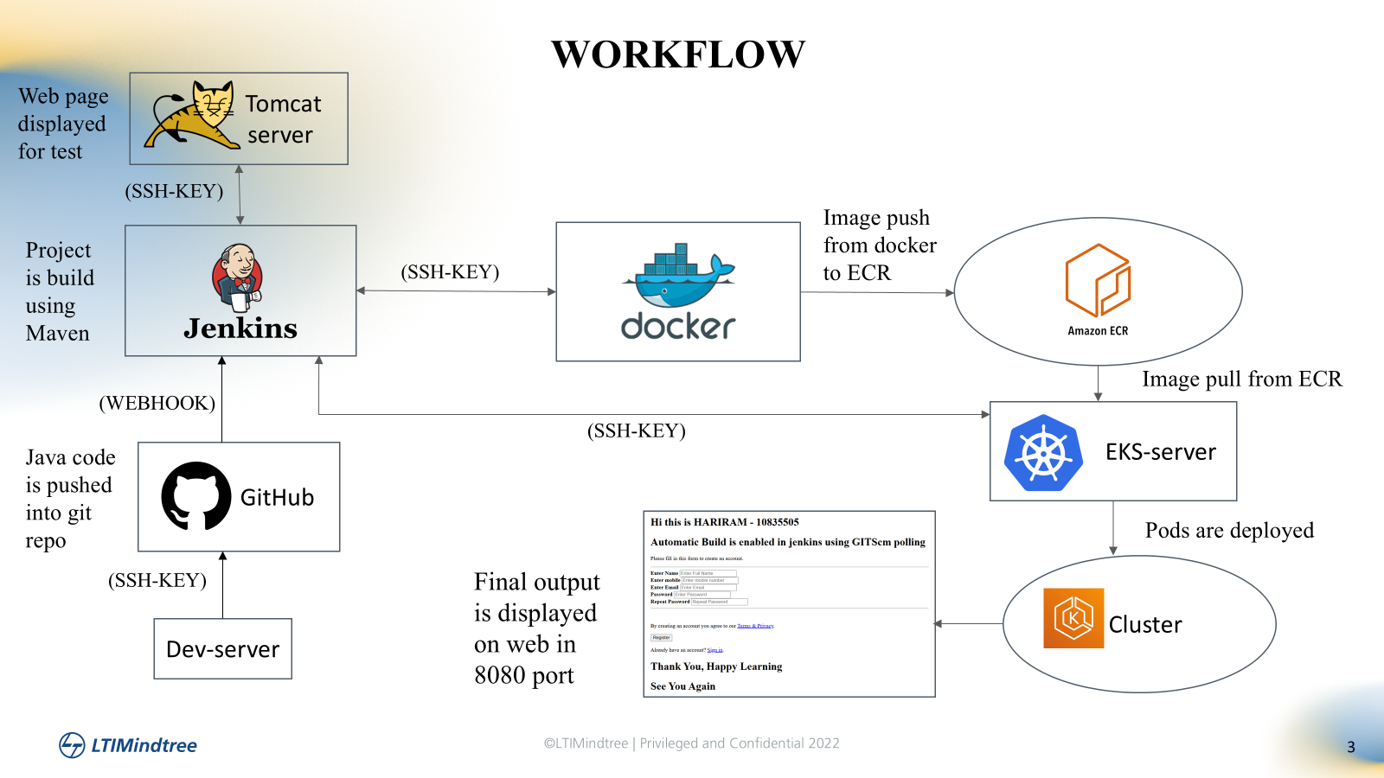
Workflow

Slide 5
Developer Machine
Role:- Code Development and push to GitHub
Install git on the developer machine.
Generate ssh-key and add to github for integration between github and developer machine to push code
Clone the java code repo
Pushing the code to github

Slide 6
GitHub
Role: code repository & webhook Trigger
Github hosts the source code
Webhook is set up to automatically notify when new code is pushed
This enables continuous integration by triggering a Jenkins code

Slide 7
Jenkins Server
Role: Automates the entire CI/CD pipeline
Code checkout :- Jenkins pulls the code using the github webhook
Build Stage:- Uses maven to build the .war file
Deploy to Tomcat:- Jenkins connects to tomcat server via ssh.
deploys the generated .war file for testing
Docker Build Stage:- Creates tomcat image
Push to Amazon ECR:- tag and push the docker image
Deploy to Kubernetes:- ssh into Kubernetes server
apply YAML

Slide 8
Tomcat Server
Role:- Test Environment
Jenkins’s ssh key is added into tomcat server under .ssh/authorized_keys
Uploads the .war file to /opt/tomcat/webapps
Tomcat auto-deploys the application
Used only for pre-docker testing to validate war correctness

Slide 9
Docker Server
Role: build and push docker images
Jenkins ssh’s key in added to docker server
Docker must be installed and configured
AWS CLI must be configured on docker host to authenticate ECR

Slide 10
Amazon ECR-Image Registry
Role:- Stores Docker images for Kubernetes
Receives Docker images pushed from Docker host.
Makes the image available for pulling by Kubernetes cluster

Slide 11
Amazon EKS- Kubernetes Cluster
Role: Final Deployment & orchestration
Jenkins connects to EKS server via ssh
Runs deployment.yaml and service.yaml
Kuberentes pulls the image form ECR
Pods and services are created and exposed
EKS Setup
Kubectl and AWS CLI must be installed
IAM roles must allow pulling images from ECR.

Slide 12
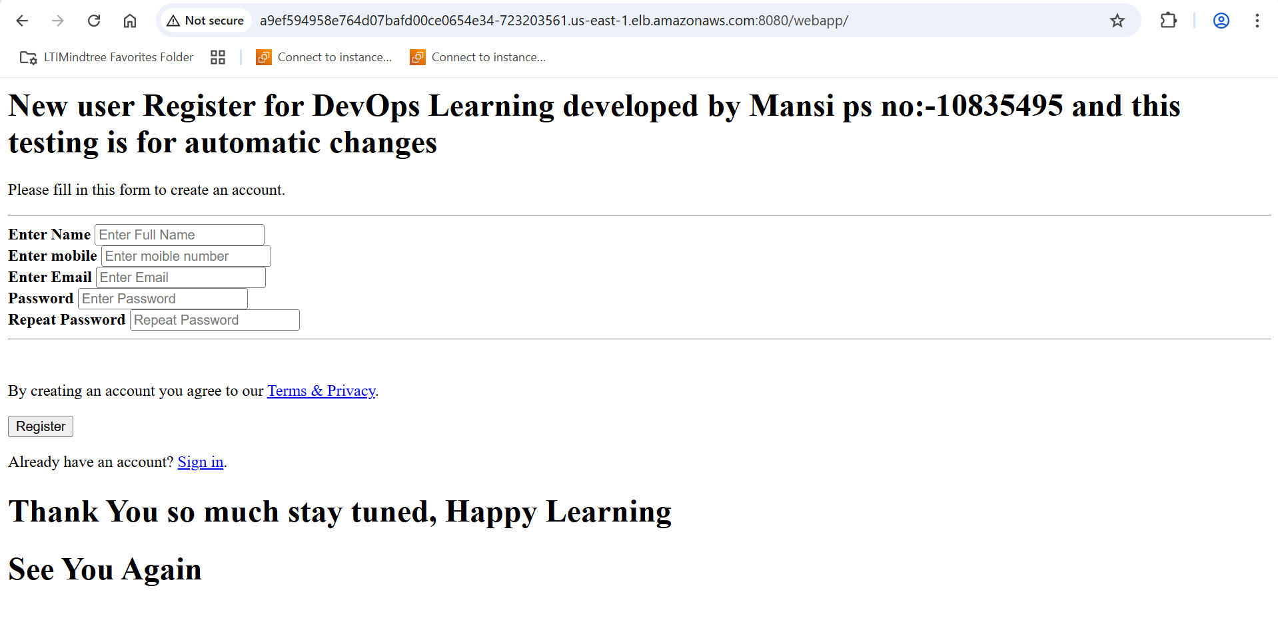
Final Output

Slide 13
THANK YOU

